Slide 1
Table of Contents
This slide deck consists of slides used in 7 lecture videos in Week 4. Below is a list of shortcut hyperlinks for you to jump into specific sections.
(page 2) Week 4: Forms, GET, POST, and HTTP
(page 10) Week 4: Building HTML Forms
(page 21) Week 4: Forms and Cross Site Reqeust Forgery (CSRF)
(page 30) Week 4: CSRF Support in Django
(page 44) Week 4: The POST Refresh Pattern
(page 49) Week 4: Implementing POST Redirect in Django
Notes:
Note from Chuck. If you are using these materials, you can remove my name and URL from this replace it with your own, but please retain the CC-BY logo on the first page as well as retain the entire last page when you remix and republish these slides.
TO Highlight – go to https://tohtml.com/html/ - paste and then do a "Paste RTF"

Slide 2

Form Processing
Charles Severance
www.dj4e.com
https://samples.dj4e.com/getpost/
https://samples.dj4e.com/form/

Slide 3
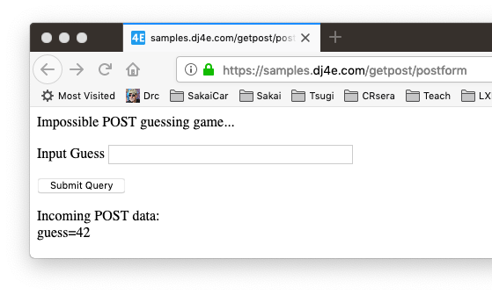
Forms gather data and send it to the server

Slide 4
Forms GET vs. POST
Two ways the browser can send parameters to the web server
GET - Parameters are placed on the URL which is retrieved.
POST - The URL is retrieved and parameters are appended to the request in the the HTTP connection.

Slide 5
Utility Code – Dump a Dictionary
# Call as dumpdata('GET', request.GET)
def dumpdata(place, data) :
retval = ""
if len(data) > 0 :
retval += '<p>Incoming '+place+' data:<br/>\n'
for key, value in data.items():
retval += html.escape(key) + '=' + html.escape(value) + '</br>\n'
retval += '</p>\n'
return retval
dj4e-samples/getpost/views.py

Slide 6
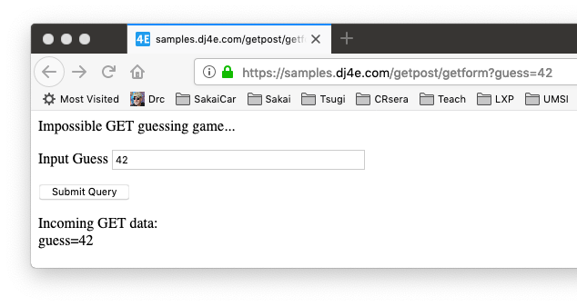
Form Processing
def getform(request):
response = """<p>Impossible GET guessing game...</p>
<form>
<p><label for="guess">Input Guess</label>
<input type="text" name="guess" size="40" id="guess"/></p>
<input type="submit"/>
</form>"""
response += dumpdata('GET', request.GET)
return HttpResponse(response)
dj4e-samples/getpost/views.py
https://samples.dj4e.com/getpost/getform
Notes:
When clic “submit Query”, the input data will put on the url “guess=42” and “42” been parased and displayed

Slide 7

Form Processing
@csrf_exempt
def postform(request):
response = """<p>Impossible POST guessing game...</p>
<form method="POST">
<p><label for="guess">Input Guess</label>
<input type="text" name="guess" size="40" id="guess"/></p>
<input type="submit"/>
</form>"""
response += dumpdata('POST', request.POST)
return HttpResponse(response)
dj4e-samples/getpost/views.py
https://samples.dj4e.com/getpost/postform

Slide 8
Passing Parameters to The Server
GET /form/getform?guess=42
Accept: text/html
User-Agent: Lynx/2.4 libwww/2.14
Web Server
HTTP
Request
POST /form/postform
Accept: text/html
User-Agent: Lynx/2.4 libwww/2.14
Content-type: application/x-www-form-urlencoded
Content-length: 13
guess=42
Browser
<input type="text" name="guess" id="yourid" />

Slide 9
Rules of the POST/GET Choice
POST is used when data is being created or modified.
GET is used when your are reading or searching things.
GET should never be used to insert, modify or delete data.
Web search spiders will follow GET URLs but generally not POST URLs.
GET URLs should be “idempotent” - the same URL should give the “same thing” each time you access it. (i.e. bookmarkable)
GET has an upper limit of the number of bytes of parameters and values (think about 2K).

Slide 10
FORMS in HTML

Slide 11
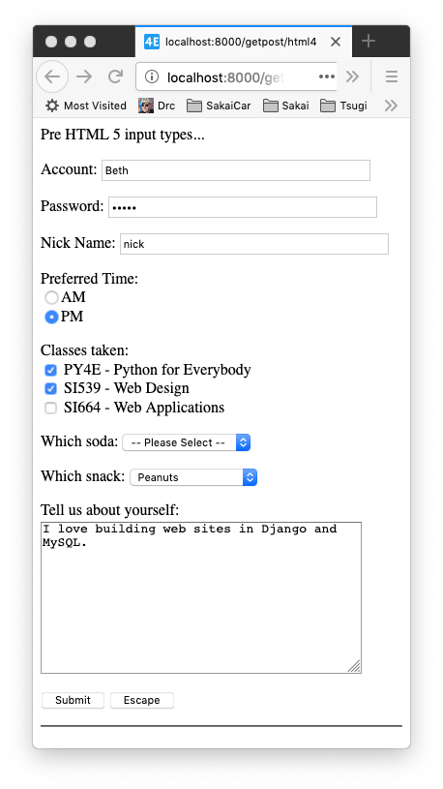
Pre HTML5 Input Types
Text
Password
Radio Button
Check Box
Select / Drop-Down
Textarea
https://samples.dj4e.com/getpost/html4
dj4e-samples/getpost/templates/getpost/html4.html

Slide 12
Forms in HTML
<p>Many field types...</p>
<form method="post">
<p><label for="inp01">Account:</label>
<input type="text" name="account" id="inp01" size="40" ></p>
<p><label for="inp02">Password:</label>
<input type="password" name="pw" id="inp02" size="40" ></p>
<p><label for="inp03">Nick Name:</label>
<input type="text" name="nick" id="inp03" size="40" ></p>
Incoming POST data: account=Beth pw=12345 nick=nick when=pm ...

Slide 13
Forms in HTML
dj4e-samples/getpost/templates/getpost/html4.html
<p>Preferred Time:<br/>
<input type="radio" name="when" value="am">AM<br>
<input type="radio" name="when" value="pm" checked>PM</p>
Incoming POST data: ... when=pm class1=on class2=si539 ...

Slide 14
Forms in HTML
<p>Classes taken:<br/>
<input type="checkbox" name="class1">
PY4E - Python for Everybody<br>
<input type="checkbox" name="class2" value="si539" checked>
SI539 - Web Design<br>
<input type="checkbox" name="class3" value="si664">
SI664 - Web Applications<br>
</p>
Incoming POST data: ... when=pm class1=on class2=si539 ...

Slide 15
Forms in HTML
<p><label for="inp06">Which soda:
<select name="soda" id="inp06">
<option value="0">-- Please Select --</option>
<option value="1">Coke</option>
<option value="2">Pepsi</option>
<option value="3">Mountain Dew</option>
<option value="4">Orange Juice</option>
<option value="5">Lemonade</option>
</select>
</p>
The values can be any string, but numbers are used quite often.
Incoming POST data: ... soda=0 snack=peanuts ...

Slide 16
Forms in HTML
<p><label for="inp07">Which snack:
<select name="snack" id="inp07">
<option value="">-- Please Select --</option>
<option value="chips">Chips</option>
<option value="peanuts" selected>Peanuts</option>
<option value="cookie">Cookie</option>
</select>
</p>
Incoming POST data: ... soda=0 snack=peanuts ...

Slide 17
Forms in HTML
dj4e-samples/getpost/templates/getpost/html4.html
<p><label for="inp08">Tell us about yourself:<br/>
<textarea rows="10" cols="40" id="inp08" name="about">
I love building web sites in Django and MySQL.
</textarea>
</p>
Incoming POST data: ... snack=peanuts about=I love building web sites in Django and MySQL. dopost=Submit

Slide 18
Forms in HTML
dj4e-samples/getpost/templates/getpost/html4.html
<input type="submit" name="dopost" value="Submit"/>
<input type="button"
onclick="location.href='http://www.dj4e.com/'; return false;"
value="Escape">
Incoming POST data: ... snack=peanuts about=I love building web sites in Django and MySQL. dopost=Submit

Slide 19
HTML5 Input Types
HTML5 defined new input types
Not all browsers support all input types
They fall back to type="text"
https://samples.dj4e.com/getpost/html5
dj4e-samples/getpost/templates/getpost/html5.html
http://www.w3schools.com/html/html5_form_input_types.asp

Slide 20
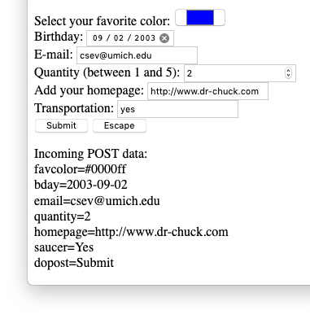
Input Types
Select your favorite color:
<input type="color" name="favcolor" value="#0000ff"><br/>
Birthday:
<input type="date" name="bday" value="2003-09-02"><br/>
E-mail:
<input type="email" name="email"><br/>
Quantity (between 1 and 5):
<input type="number" name="quantity"
min="1" max="5"><br/>
Add your homepage:
<input type="url" name="homepage"><br>
Transportation:
<input type="flying" name="saucer"><br>
In-browser validation happens when you press submit.
https://samples.dj4e.com/getpost/html5

Slide 21
Cross-Site-Request-Forgery (CSRF)
Security

Slide 22
CSRF Attack
A rogue site generates a page that includes form that posts data to a legitimate site where the user is logged in via a session cookie
The form is submitted to the legitimate site and the cookie is included
The legitimate site accepts the request because of the cookie value
Note that the rogue site does not need to know the cookie value – it just knows that the cookie will be sent on requests to the legitimate site
https://en.wikipedia.org/wiki/Cross-site_request_forgery

Slide 23
CSRF Defense
The legitimate site chooses a large random number (the CSRF Token) and puts it in the session
When the legitimate site generates a POST form, it includes the CSRF Token as a hidden input field
When the form is submitted the CSRF Token is sent as well as the cookie
The site looks up the session and rejects the request if the incoming CSRF Token does not match the session's CSRF Token
https://en.wikipedia.org/wiki/Cross-site_request_forgery

Slide 24
Scenario: Time to Change a Student Grade
www.dj4e.com
Browser
Page produced by legit server.
<form method="post"
action="https://www.dj4e.com/grades/123">
<input type="text" name="new-grade"
value="0.5">
<input type="submit">
</form>
user: csev
instructor: true
42
POST /grades/123
cookie: sessid=42
new-grade=0.5
cookies
www.dj4e.com
sessid: 42
Student | Grade
123 | 0.5
456 | 1.0
Notes:
After we fill in the form and click submit button, the brower will generate a cookies file (which cotains sessionid). Both the form and cookie will be sent to the server.
When server receives the sessionID, it will check sessionID (e.g. session 42, instructor login)

Slide 25
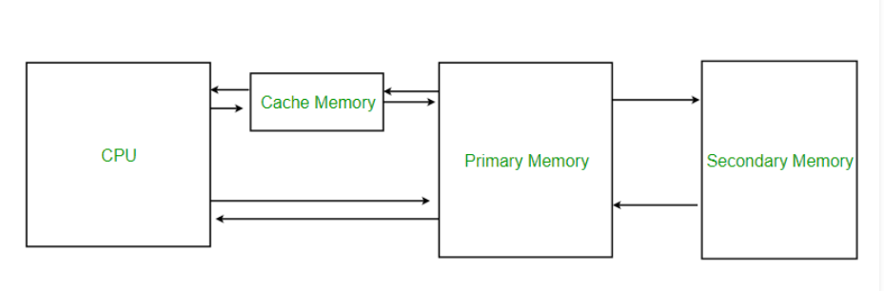
What is cached memory
Cache memory is an extremely fast memory type that acts as a buffer between RAM and the CPU. It holds frequently requested data and instructions so that they are immediately available to the CPU when needed.

Slide 26
What is cached files
Cached files are temporary files that your computer downloads and stores to save time in the future.
For example, when you visit a website, your browser downloads the images and saves them in a cache folder. The next time you visit the site, your browser quickly loads the data from the cache rather than downloading it again
Other apps such as photo and video editing software also create cached data.

Slide 27
Attack (without CSRF)
www.csrf.com
Browser
Page produced by rogue server.
<form method="post"
action="https://www.dj4e.com/grades/123">
<input type="text" name="new-grade"
value="1.0">
<input type="submit">
</form>
user: csev
instructor: true
42
www.dj4e.com
POST /grades/123
cookie: sessid=42
new-grade=1.0
cookies
www.dj4e.com
sessid: 42
Student | Grade
123 | 1.0
456 | 1.0

Slide 28
With CSRF
www.dj4e.com
Browser
Page produced by legit server.
<form method="post"
action="https://www.dj4e.com/grades/123">
<input type="hidden" name="csrf" value="99">
<input type="text" name="new-grade"
value="0.5">
<input type="submit">
</form>
user: csev
instructor: true
csrf: 99
42
POST /grades/123
cookie: sessid=42
new-grade=0.5
csrf=99
cookies
www.dj4e.com
sessid: 42
Student | Grade
123 | 0.5
456 | 1.0
Notes:
With CSRF implementation, the legit server adds another value csrf(e.g99)

Slide 29
CSRF Attack Blocked
www.csrf.com
Browser
Page produced by rogue server.
<form method="post"
action="https://www.dj4e.com/grades/123">
<input type="hidden" name="csrf" value="42">
<input type="text" name="new-grade"
value="1.0">
<input type="submit">
</form>
user: csev
instructor: true
csrf: 99
42
www.dj4e.com
POST /grades/123
cookie: sessid=42
new-grade=1.0
csrf=42
cookies
www.dj4e.com
sessid: 42
STOP
Student | Grade
123 | 0.5
456 | 1.0

Slide 30
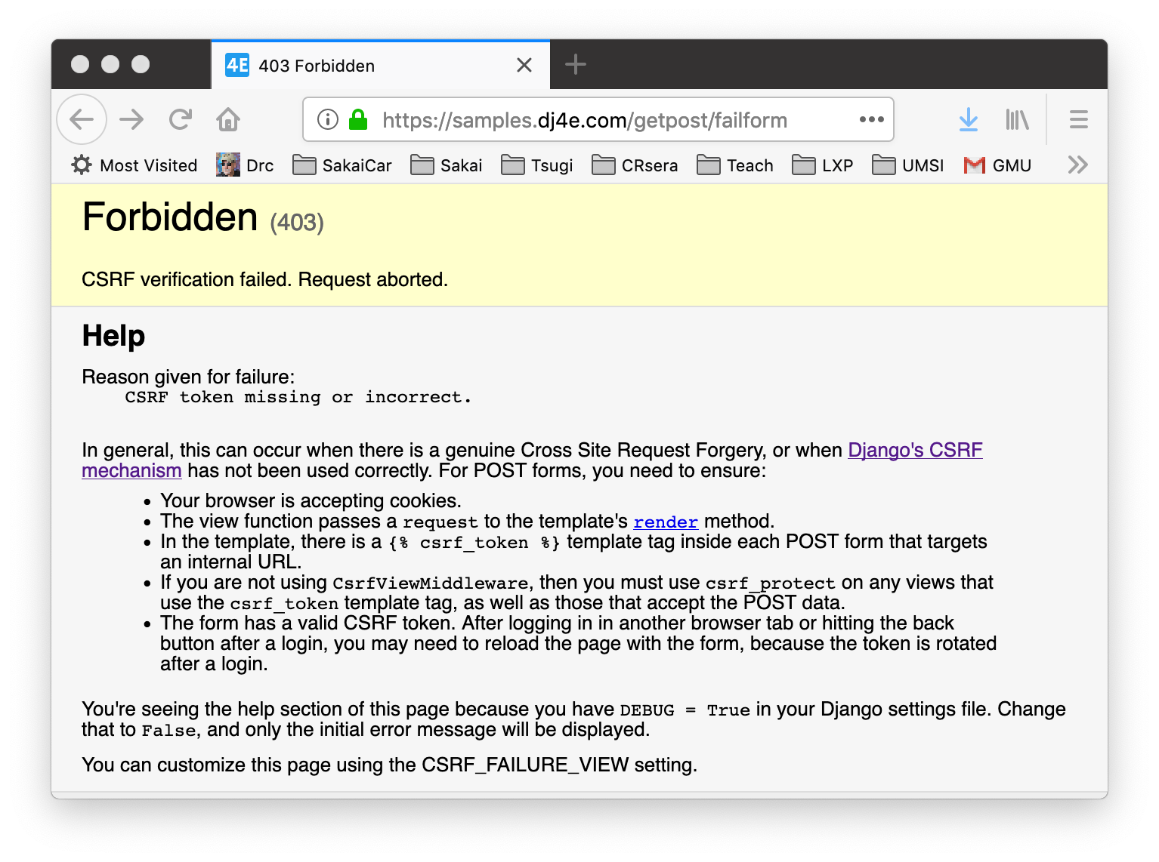
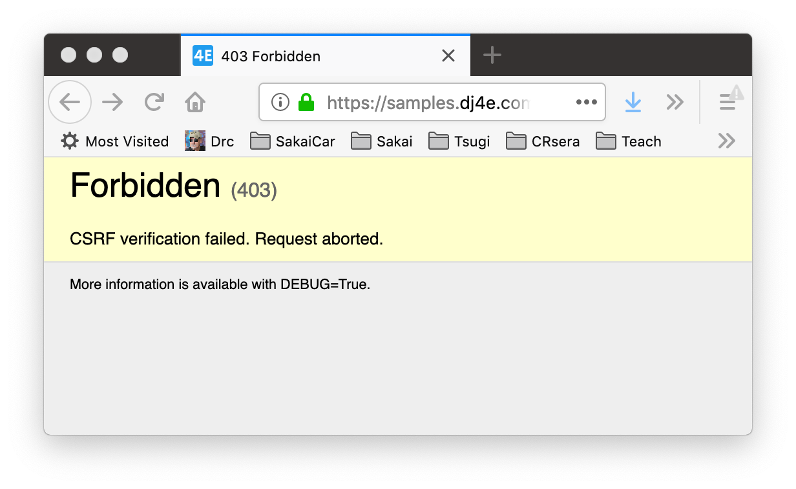
CSRF Attack Blocked

Slide 31
Enabling CSRF defense in Django
Django has built in support to generate, use, and check CSRF Tokens
Activated by default in settings.py
MIDDLEWARE = [
'django.middleware.security.SecurityMiddleware',
'django.contrib.sessions.middleware.SessionMiddleware',
'django.middleware.common.CommonMiddleware',
'django.middleware.csrf.CsrfViewMiddleware',
'django.contrib.auth.middleware.AuthenticationMiddleware',
'django.contrib.messages.middleware.MessageMiddleware',
'django.middleware.clickjacking.XFrameOptionsMiddleware',
]

Slide 32
CSRF in forms

Slide 33
Remember…..
dj4e-samples/getpost/views.py
@csrf_exempt
def postform(request):
response = """<p>Impossible POST guessing game...</p>
<form method="POST">
<p><label for="guess">Input Guess</label>
<input type="text" name="guess" size="40" id="guess"/></p>
<input type="submit"/>
</form>"""
response += dumpdata('POST', request.POST)
return HttpResponse(response)

Slide 34
CSRF
https://samples.dj4e.com/getpost/failform
def failform(request):
response = """<p>CSRF Fail guessing game...</p>
<form method="post">
<p><label for="guess">Input Guess</label>
<input type="text" name="guess" size="40" id="guess"/></p>
<input type="submit"/>
</form>"""
response += dumpdata('POST', request.POST)
return HttpResponse(response)

Slide 35
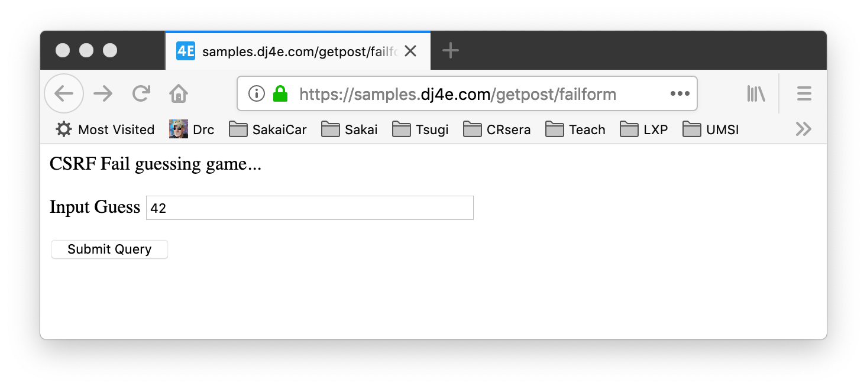
CSRF
https://samples.dj4e.com/getpost/failform

Slide 36
CSRF

Slide 37
CSRF
https://samples.dj4e.com/getpost/csrfform
from django.middleware.csrf import get_token
def csrfform(request):
response = """<p>CSRF Success guessing game...</p>
<form method="POST">
<p><label for="guess">Input Guess</label>
<input type="text" name="guess" size="40" id="guess"/></p>
<input type="hidden" name="csrfmiddlewaretoken"
value="__token__"/>
<input type="submit"/>
</form>"""
token = get_token(request)
response = response.replace('__token__', html.escape(token))
response += dumpdata('POST', request.POST)
return HttpResponse(response)

Slide 38
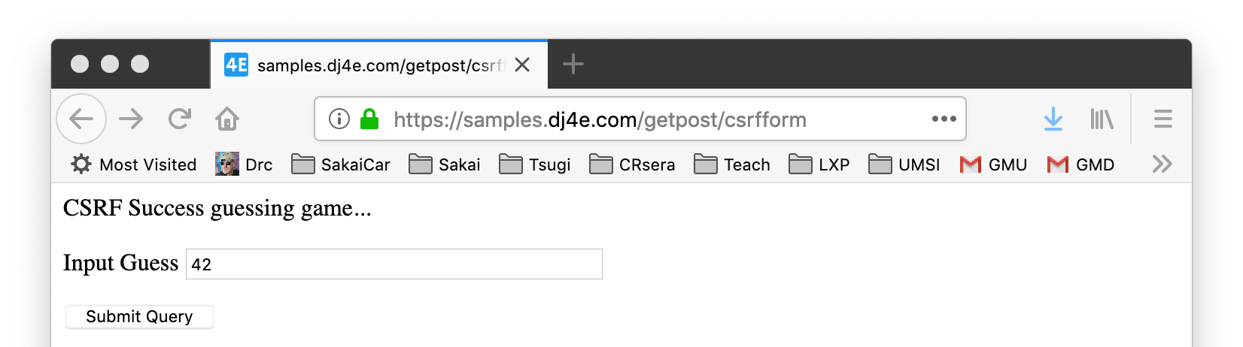
CSRF
<p>CSRF Success guessing game...</p>
<form method="POST">
<p><label for="guess">Input Guess</label>
<input type="text" name="guess" size="40" id="guess"/></p>
<input type="hidden" name="csrfmiddlewaretoken"
value="fSv596BjrYhRoBkJO08jWm0h3TrTxqiIj5x32K0vXgHaHjSlX33UCJfz52b0CVa2"/>
<input type="submit"/>
</form>

Slide 39
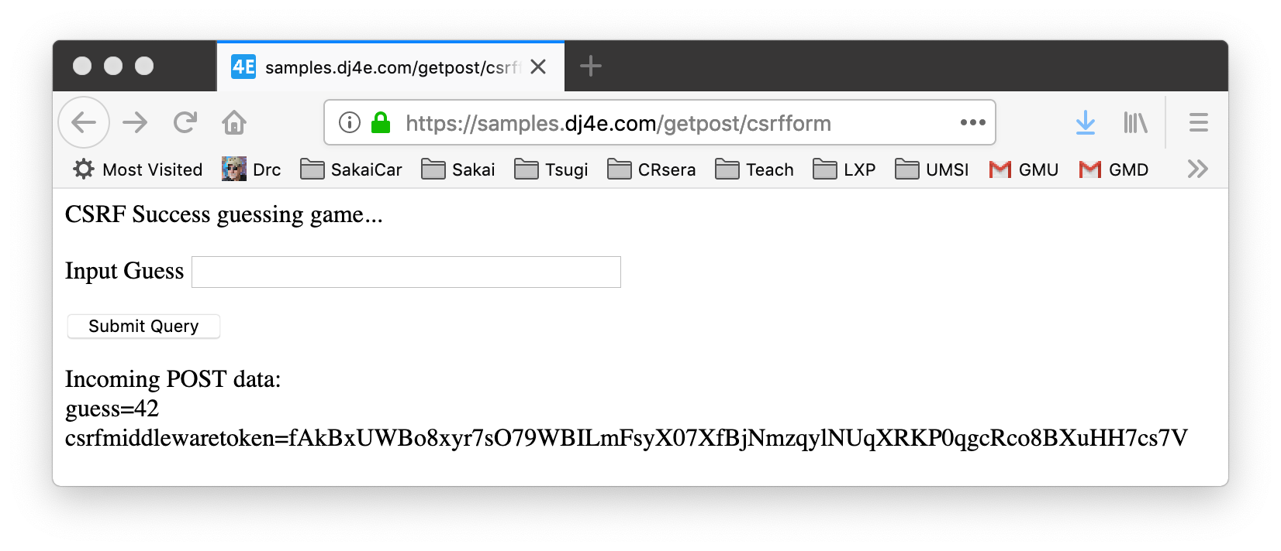
CSRF

Slide 40
Django CSRF in Templates
<p>Guessing game</p>
{% if message %}
<p>{{ message }}</p>
{% endif %}
<form method="post">
<p><label for="guess">Input Guess</label>
{% csrf_token %}
<input type="text" name="guess" size="40" id="guess"/></p>
<input type="submit"/>
</form>
dj4e-samples/getpost/templates/getpost/guess.html

Slide 41
Utility Code for Guesses
dj4e-samples/getpost/views.py
# Call as checkguess('42')
def checkguess(guess) :
msg = False
if guess :
try:
if int(guess) < 42 :
msg = 'Guess too low'
elif int(guess) > 42 :
msg = 'Guess too high'
else:
msg = 'Congratulations!'
except:
msg = 'Bad format for guess:' + html.escape(guess)
return msg

Slide 42
CSRF
class ClassyView(View) :
def get(self, request):
return render(request, 'getpost/guess.html')
def post(self, request):
guess = request.POST.get('guess')
msg = checkguess(guess)
return render(request, 'getpost/guess.html', {'message' : msg })
dj4e-samples/getpost/views.py
<p>Guessing game</p>
{% if message %}
<p>{{ message }}</p>
{% endif %}
<form method="post">
<p><label for="guess">Input Guess</label>
{% csrf_token %}
<input type="text" name="guess" size="40" id="guess"/></p>
<input type="submit"/>
</form>
dj4e-samples/getpost/templates/getpost/guess.html

Slide 43
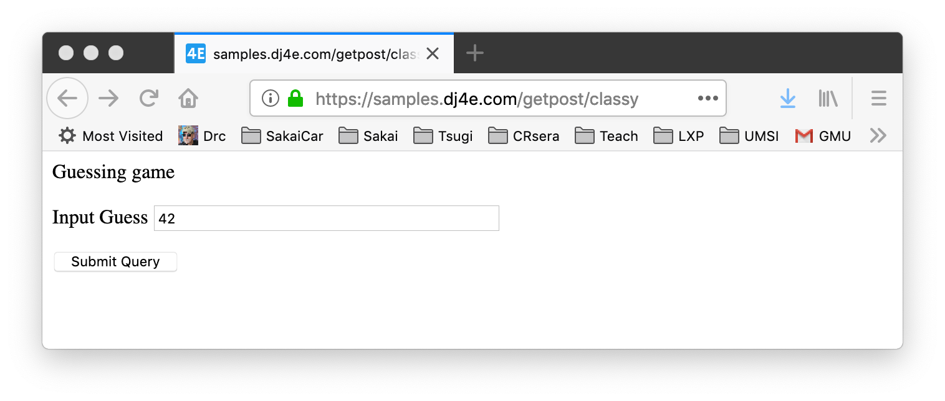
CSRF
class ClassyView(View) :
def get(self, request):
return render(request, 'getpost/guess.html')
def post(self, request):
guess = request.POST.get('guess')
msg = checkguess(guess)
return render(request, 'getpost/guess.html', {'message' : msg })
dj4e-samples/getpost/views.py
https://samples.dj4e.com/getpost/classy

Slide 44
CSRF
https://samples.dj4e.com/getpost/classy
<p>Guessing game</p>
<form method="post">
<p><label for="guess">Input Guess</label>
<input type="hidden" name="csrfmiddlewaretoken" value="1oV2XIi9kNx710Lcu9V4rf0TmMsAZm9w5BX0QmHlQ5XqkIjODcQF7CfboVcH4R1Q">
<input type="text" name="guess" size="40" id="guess"/></p>
<input type="submit"/>
</form>

Slide 45
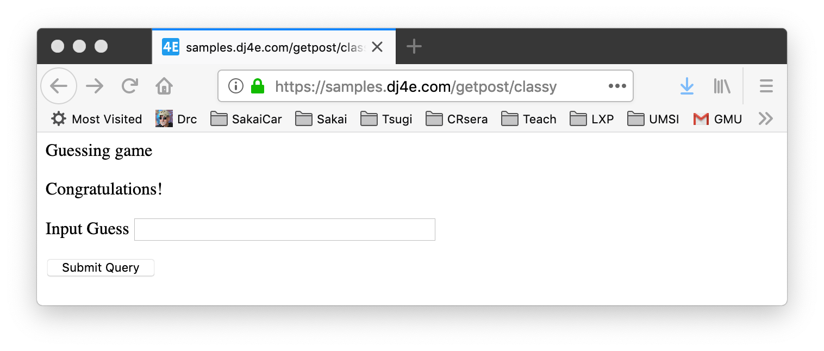
CSRF
https://samples.dj4e.com/getpost/classy
Success!!!!!

Slide 46
POST-Refresh … Oops!

Slide 47
Remember this?
https://samples.dj4e.com/getpost/classy
Success!!!!!

Slide 48
POST / Refresh / ☹
Once you do a POST and receive 200 status + a page of HTML, if you tell the browser to refresh, the browser will re-send the POST data a second time.
The user gets a browser pop-up that tries to explain what is about to happen.

Slide 49
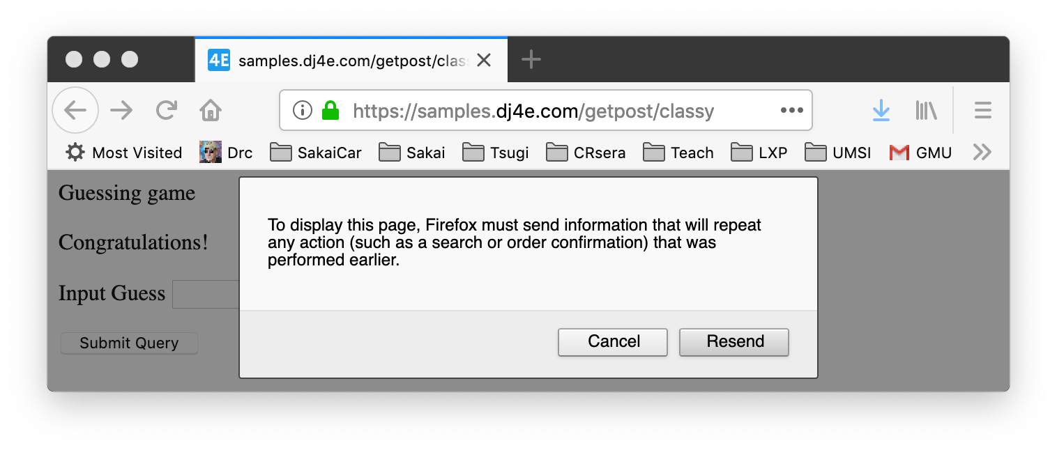
POST
Make a POST
https://samples.dj4e.com/getpost/classy
See Success
Press Refresh
Yucky Message ☹

Slide 50
Don't Allow Double Posts
Typically POST requests are adding or modifying data whilst GET requests view data
It may be dangerous to do the same POST twice (say withdrawing funds from a bank account)
So the browser insists on asking the user (out of your control)
Kind of an ugly UX / bad usability
As developers we work so this never can happen

Slide 51
POST-REDIRECT-GET-Refresh

Slide 52
POST Redirect Rule
The simple rule for pages intended for a browser is to never generate a page with HTML content when the app receives POST data and data has been modified
Must cause a GET by redirecting somewhere - even a GET to the same URL- forcing the browser to make a GET after the POST

Slide 53
Review: HTTP Status Codes
http://www.dr-chuck.com/page1.htm - 200 OK
https://samples.dj4e.com/getpost/failform - 403 Forbidden
Post data without CSRF Token
http://www.wa4e.com/nowhere.htm - 404 Not Found
http://www.drchuck.com/ - 302 Found / Moved
Also known as “redirect”
https://en.wikipedia.org/wiki/List_of_HTTP_status_codes

Slide 54
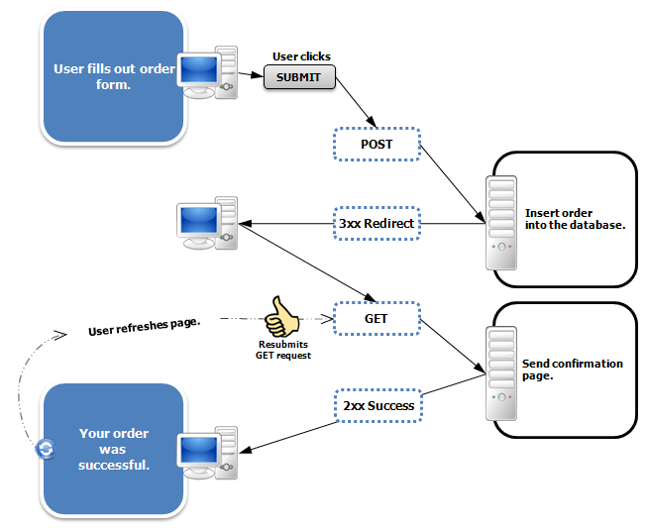
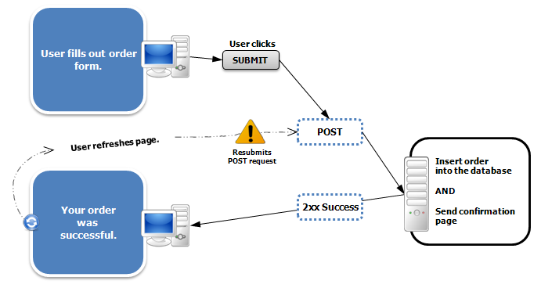
POST
https://en.wikipedia.org/wiki/Post/Redirect/Get

Slide 55
POST
class AwesomeView(View) :
def get(self, request):
msg = request.session.get('msg', False)
if ( msg ) : del(request.session['msg'])
return render(request, 'getpost/guess.html', {'message' : msg })
def post(self, request):
guess = request.POST.get('guess')
msg = checkguess(guess)
request.session['msg'] = msg
return redirect(request.path)
dj4e-samples/getpost/views.py
<p>Guessing game</p>
{% if message %}
<p>{{ message }}</p>
{% endif %}
<form method="post">
<p><label for="guess">Input Guess</label>
{% csrf_token %}
<input type="text" name="guess" size="40" id="guess"/></p>
<input type="submit"/>
</form>
dj4e-samples/getpost/templates/getpost/guess.html

Slide 56
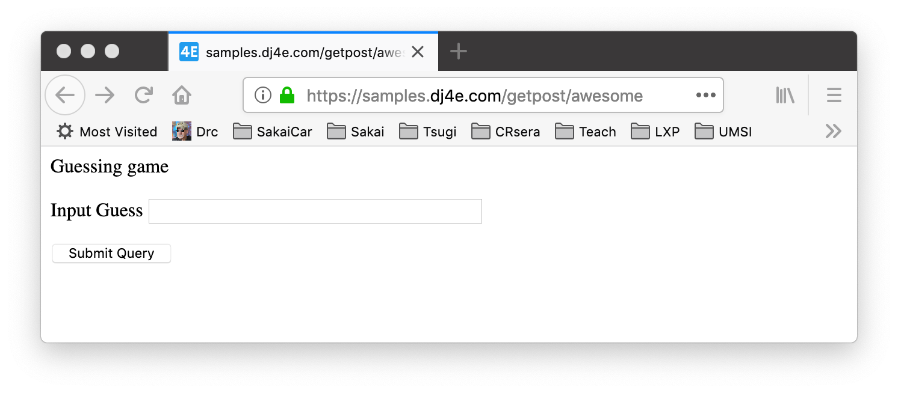
POST
https://samples.dj4e.com/getpost/awesome
Enter guess and press Submit

Slide 57
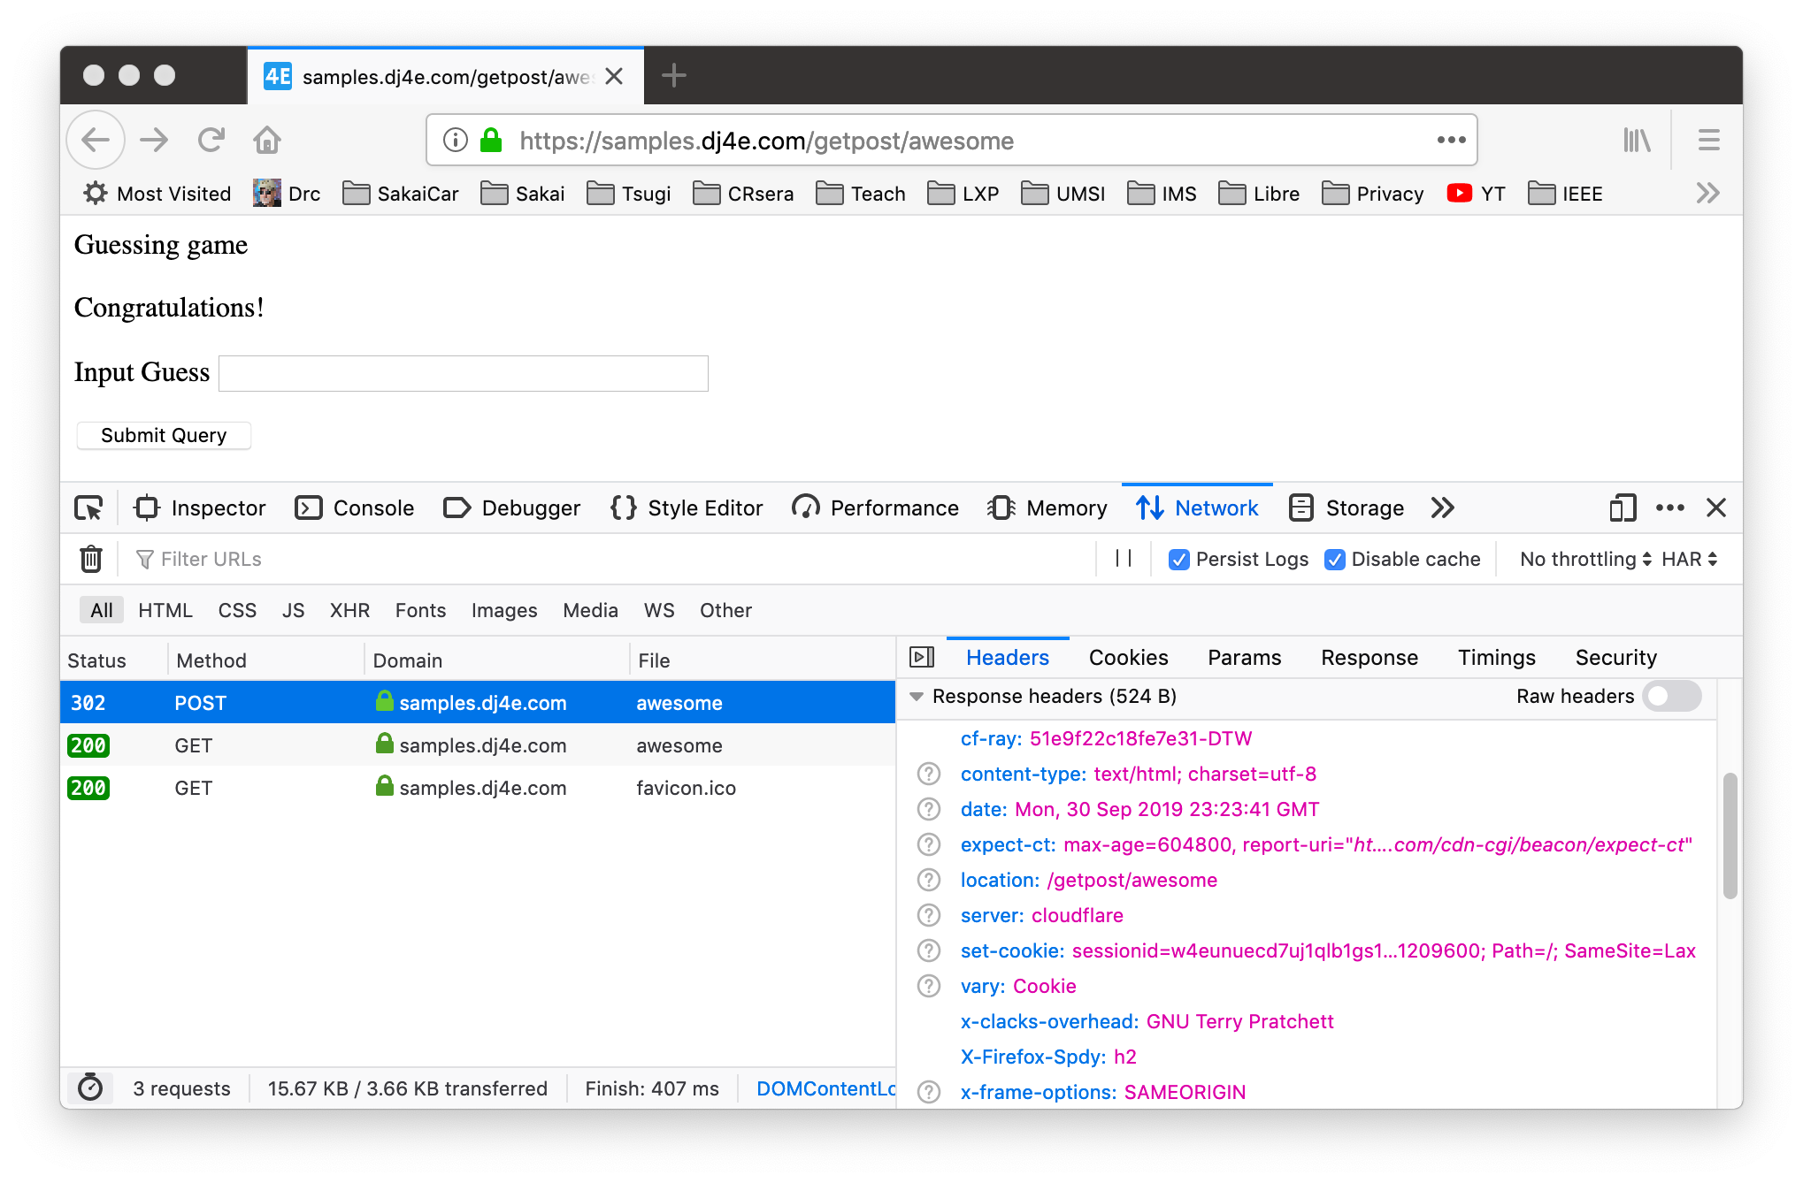
POST
POST Response

Slide 58
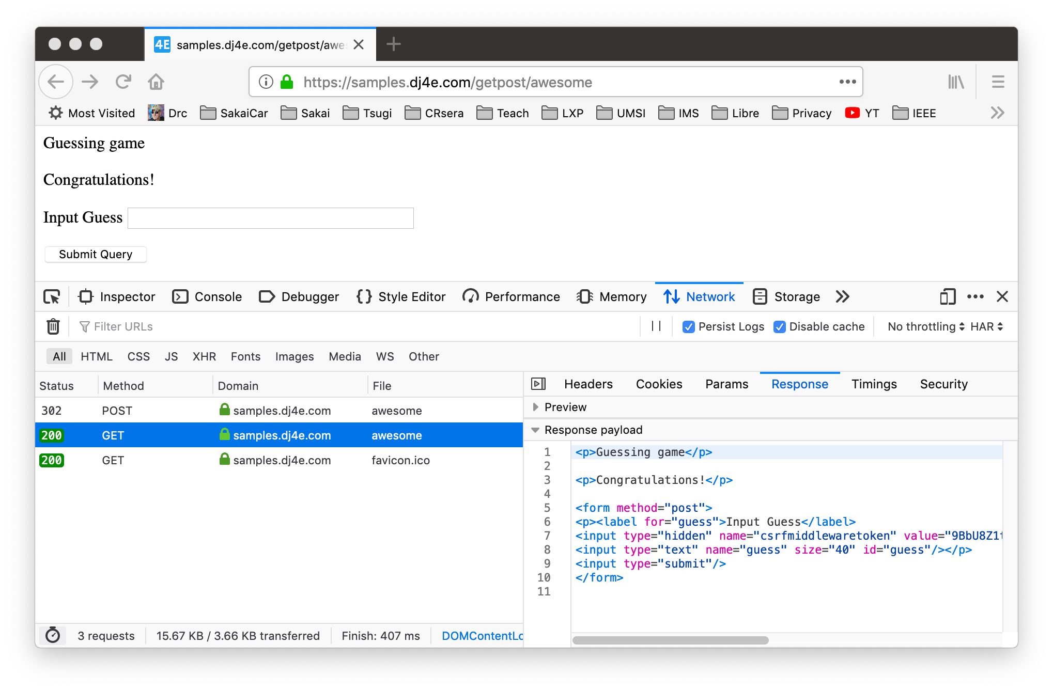
POST
GET after Redirect

Slide 59
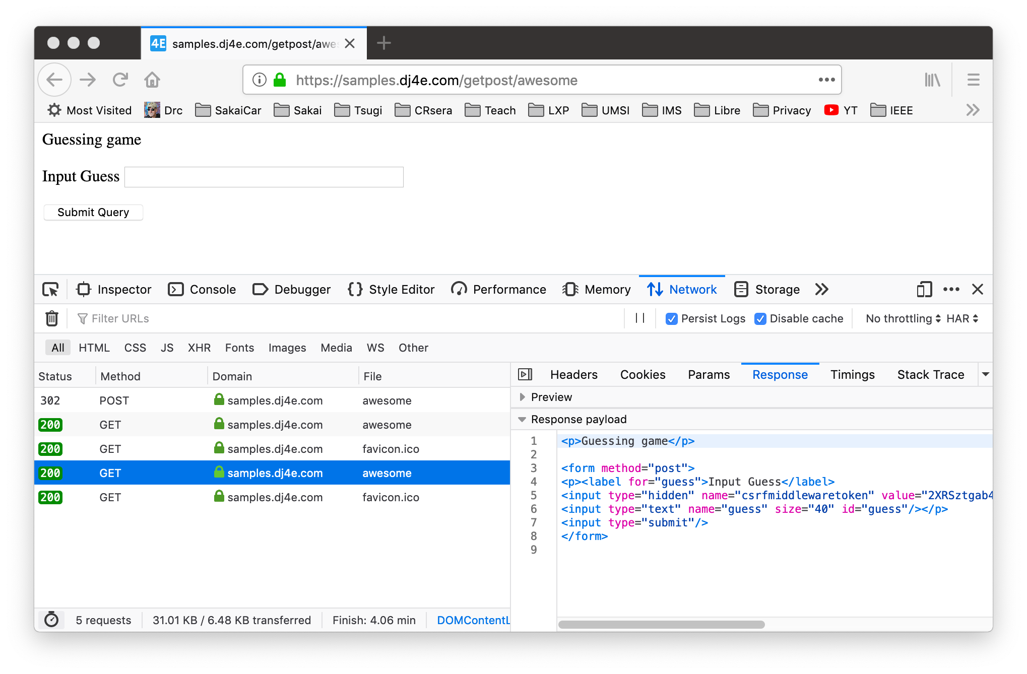
POST
Refreshed GET

Slide 60
The response to a POST must be a redirect
Pass data to the GET – "flash message pattern"
Session can be used for flash messages
class AwesomeView(View) :
def get(self, request):
msg = request.session.get('msg', False)
if ( msg ) : del(request.session['msg'])
return render(request, 'getpost/guess.html', {'message' : msg })
def post(self, request):
guess = request.POST.get('guess')
msg = checkguess(guess)
request.session['msg'] = msg
return redirect(request.path)
dj4e-samples/getpost/views.py
Notes:
-> go to a page, get request, no message
-> post request ,put in the message
-> redirect to get request
-> delete the message
-> render the page

Slide 61
Summary
HTML for Forms
GET versus POST
CSRF
POST Redirect GET

Slide 62
Acknowledgements / Contributions
These slides are Copyright 2019- Charles R. Severance (www.dr-chuck.com) as part of www.dj4e.com and made available under a Creative Commons Attribution 4.0 License. Please maintain this last slide in all copies of the document to comply with the attribution requirements of the license. If you make a change, feel free to add your name and organization to the list of contributors on this page as you republish the materials.
Initial Development: Charles Severance, University of Michigan School of Information
Insert new Contributors and Translators here including names and dates
Continue new Contributors and Translators here

Slide 63
Additional Source Information
Portions of the text of these slides is adapted from the text www.djangoproject.org web site. Those slides which use text from that site have a reference to the original text on that site. Django is licensed under the three-clause BSD license.

